Slide 1

Data Structures and Algorithms II:
An Introduction
REM COLLIER

Slide 2
Course Objectives
Understanding how to build better software.
  Appreciating when to use what data structure (and when not to).
  How to analyse the performance of some algorithm
Learning the basic tools of the trade.
  Java (and other modern languages) come with existing implementations of many data structures.
  Knowing how they work will help you to make better choices.
  Being prepared to modify the default behaviour.
Getting more coding experience.
  Learning to program is level 1
  Data Structures are the next step…

Slide 3
Course Content
Review of Collections: (2 weeks)
  Stacks, Queues, Vectors, Lists, Iterators, …
Trees
  Tree Basics / Traversal
  Binary Trees / Complete Binary Trees
  Binary Search Trees
  AVL Trees
  Splay Trees
  Red-black trees

Slide 4
Course Content
Priority Queues
  Heaps
Advanced Sort Algorithms
  Merge Sort & Quick Sort
  Bucket Sort & Radix Sort
Text Processing Algorithms
  Pattern Matching
  Text Compression
  Tries (not an algorithm per se)

Slide 5
Course Structure
Marking Scheme:
  Weekly Practicals (not Practical Exam) 20%
  Assignment 20%
  Final Examination 60%
Practical Worksheets:
  Will be based on a recent topic from the course.
  Will combine theory and/or implementation.
  Maximum 7/8 worksheets:
    Each worksheet will be released on the day of the practical and must be handed up by the following Monday (9am).
    Sample answers will be released on the Tuesday.
    We will attempt to have marks released by the following Tuesday.
    Your practical mark will be your best 5/6 submissions.

Slide 6
Course Notes
Everything will be on moodle:
  http://csmoodle.ucd.ie
Course Name:
  COMP20040 Data Structures and Algorithms II – 2018-2019
Key:
  dsaii
Site is live now!

Slide 7
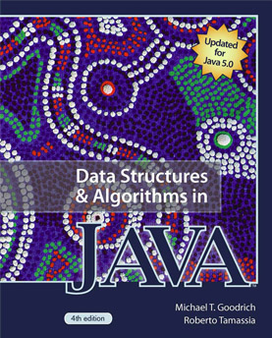
Course Book
I do not require that you buy this book!!!

